Slide 1

Data Description
Session 6
M. Kachour

Slide 2
Exercise 1
We studied the morning temperature (i.e. measured between 7am and 7.30am) over 200 days chosen randomly from the winter periods observed over the last 20 years.
The data are represented in the following table:
Calculate the mode(s) associated with the data
Calculate the average morning temperature
Temperature | Frequency
-1 | 20%
0 | 17%
2 | 43%
3 | 10%
7 | 10%

Slide 3
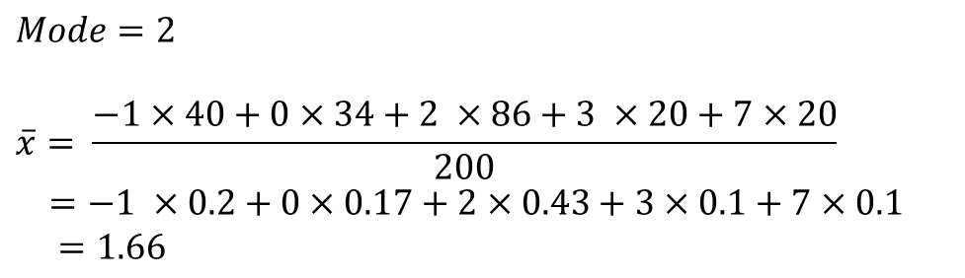

Exercise 1 - Solution
Temperature | Number of days | $$f_{i}$$
-1 | 40 | 20%
0 | 34 | 17%
2 | 86 | 43%
3 | 20 | 10%
7 | 20 | 10%
Total | 200 | 100%
$$Mode=2$$
$$\overline{x}= \frac{−1×40+0×34+2 ×86+3 ×20+7×20}{200}$$
$=−1 ×0.2+0×0.17+2×0.43+3×0.1+7×0.1$
$=1.66$

Slide 4
Exercise 2
We studied the morning speed (i.e. measured (in Km/h) between 7am and 7.30am) of the wind
over 240 days chosen randomly from the winter periods observed over the last 20 years.
The data are represented in the following table:
Calculate the mode(s) associated with the data
Calculate the mean morning wind speed
Speed | Number of days
[0 ; 10[ | 42
[10 ; 30[ | 48
[30 ; 70[ | 90
[70 ; 100[ | 24
[100 ; 150[ | 36

Slide 5
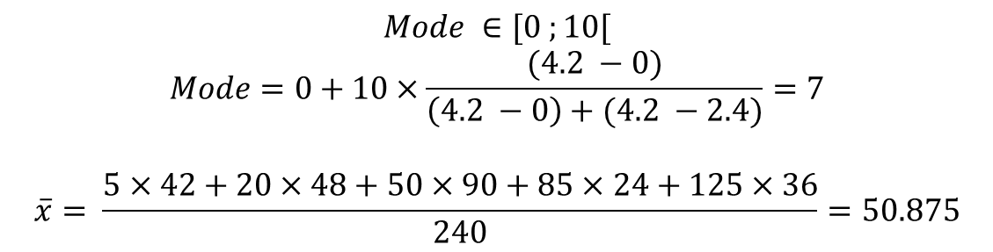
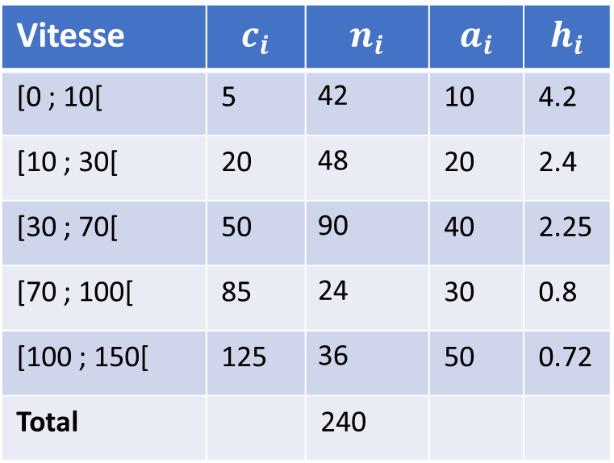
Exercise 2 - Solution
Speed | $$c_{i}$$ | $$n_{i}$$ | $$a_{i}$$ | $$h_{i}$$
[0 ; 10[ | 5 | 42 | 10 | 4.2
[10 ; 30[ | 20 | 48 | 20 | 2.4
[30 ; 70[ | 50 | 90 | 40 | 2.25
[70 ; 100[ | 85 | 24 | 30 | 0.8
[100 ; 150[ | 125 | 36 | 50 | 0.72
Total |  | 240
$$Mode ∈[0 ;10[$$
$$Mode=0+10×\frac{(4.2 −0)}{\left(4.2 −0\right)+(4.2 −2.4)}=7$$
$$\overline{x}= \frac{5×42+20×48+50×90+85×24+125×36}{240}=50.875$$

